Slide 1
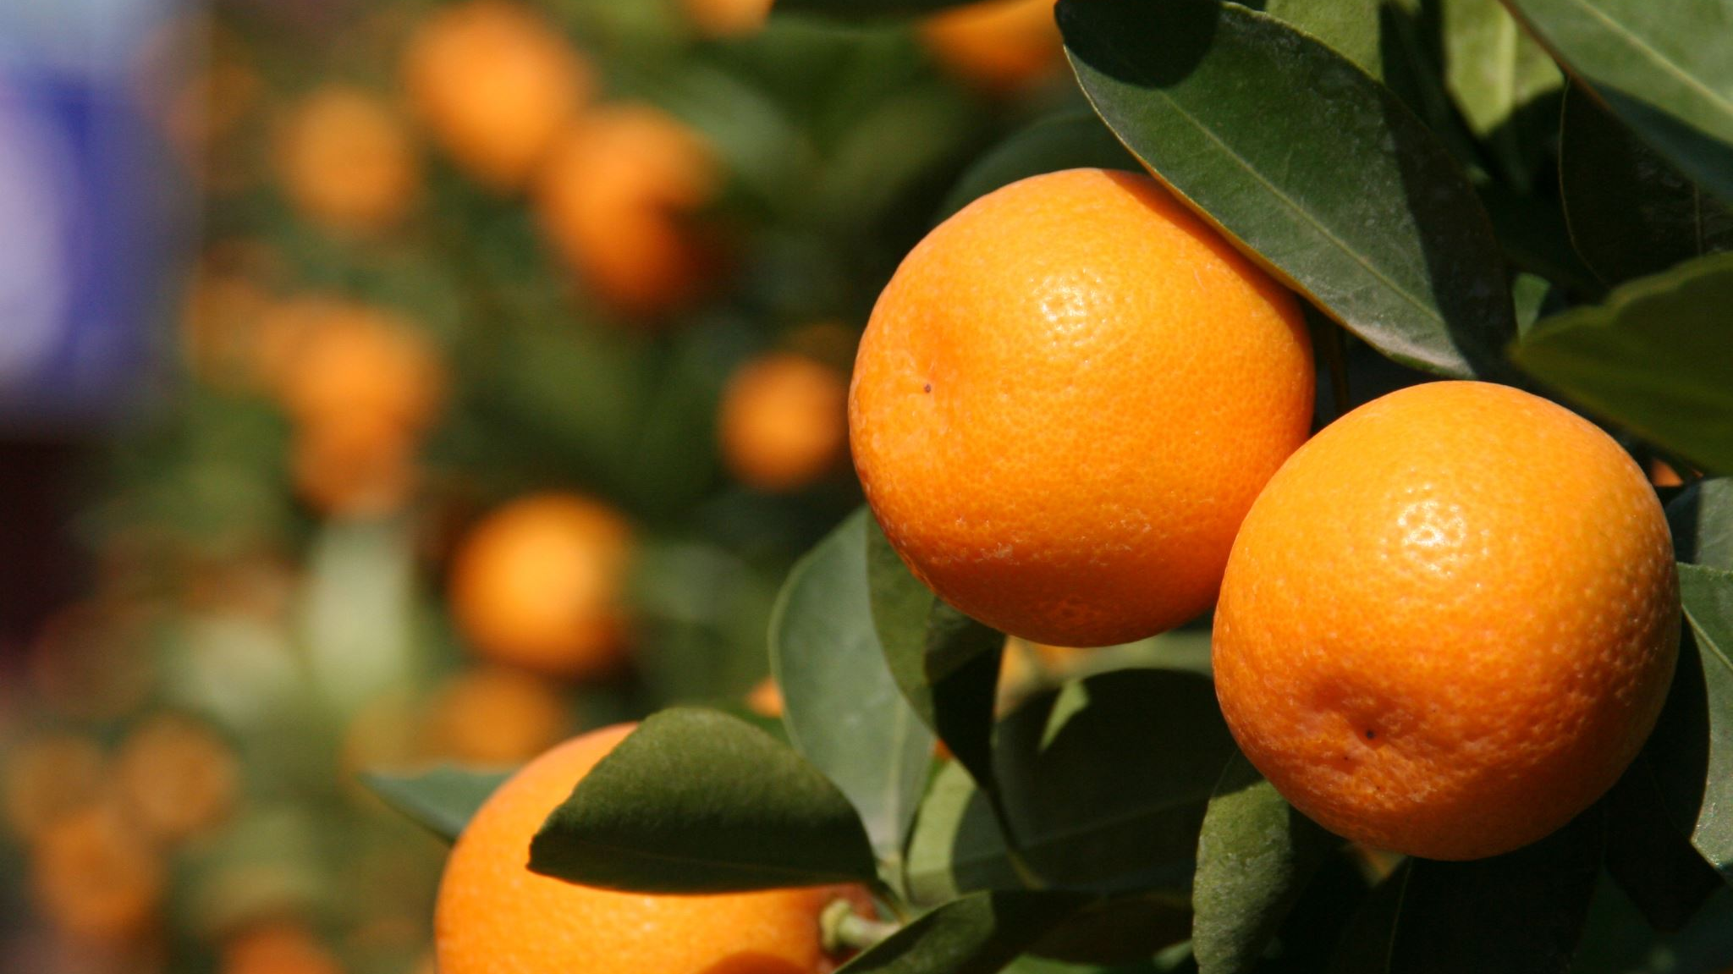

Updates to the FCS Joint Council Conference
June 2025

Slide 2
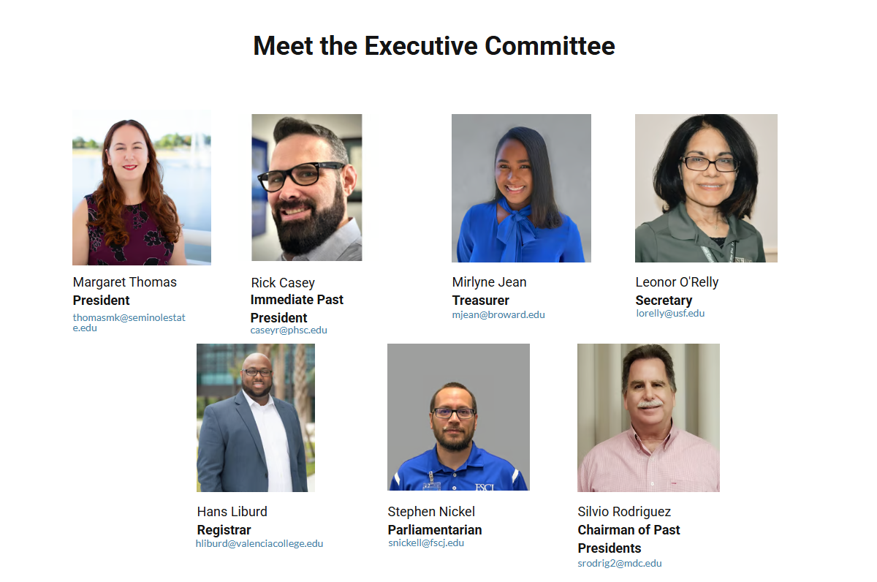

Slide 3
Striving to enhance professional testing practices
Join us at our 17th Annual Conference February 25-27, 2026 at the University of Central Florida
factatesting.org

Slide 4
Updates
Civic Literacy
  Statewide FCLE Data
  Pass Rates from 2023-2024 to 2024-2025
Level | 2023-2024 Pass Rate | 2024-2025 Pass Rate
Statewide (State and District) | 89% | 83%

Slide 5
Updates Cont.
CAPE and Certification Updates
  2025-2026 Master Credential List is available
GED
  Retake Policy is changing July 1, 2025
  Changing from two discounted retakes to one

